Slide 1
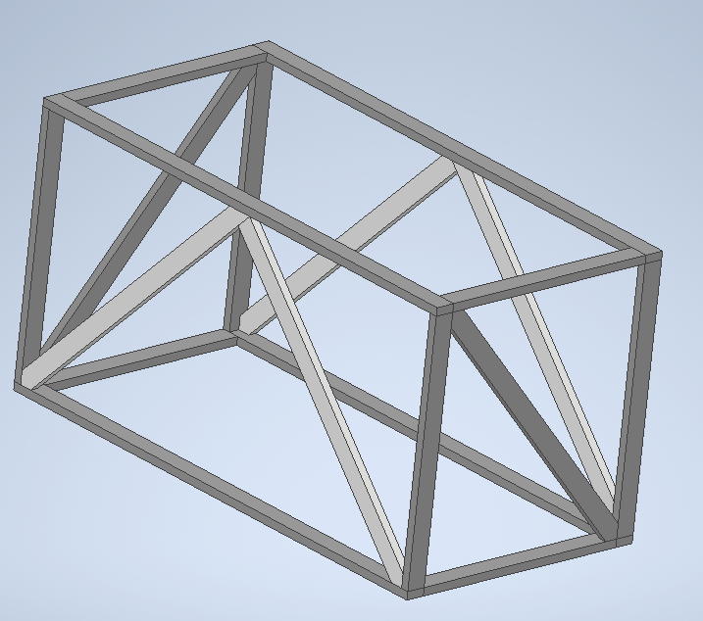
Back Foot x2
5 2x4x8
6 2x4x10

Slide 2
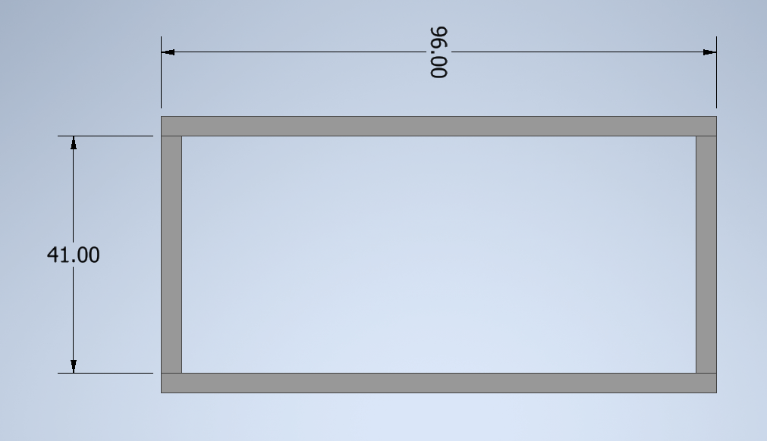
(2) 2x4x8
(2) 8’
(2) 2x4x10
(2) 41”
  Cut one from each board, save extra 79” boards

Slide 3
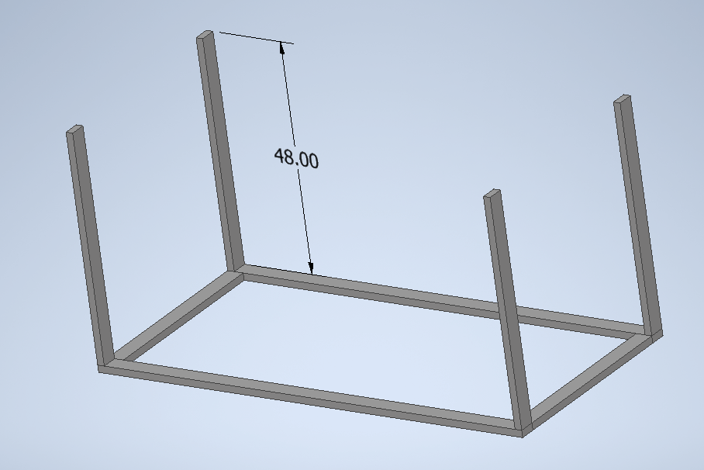
(1) 2x4x8
(2) 4’
(2) 2x4x10
(2) 4’
  One from each board, save extra 72” boards

Slide 4
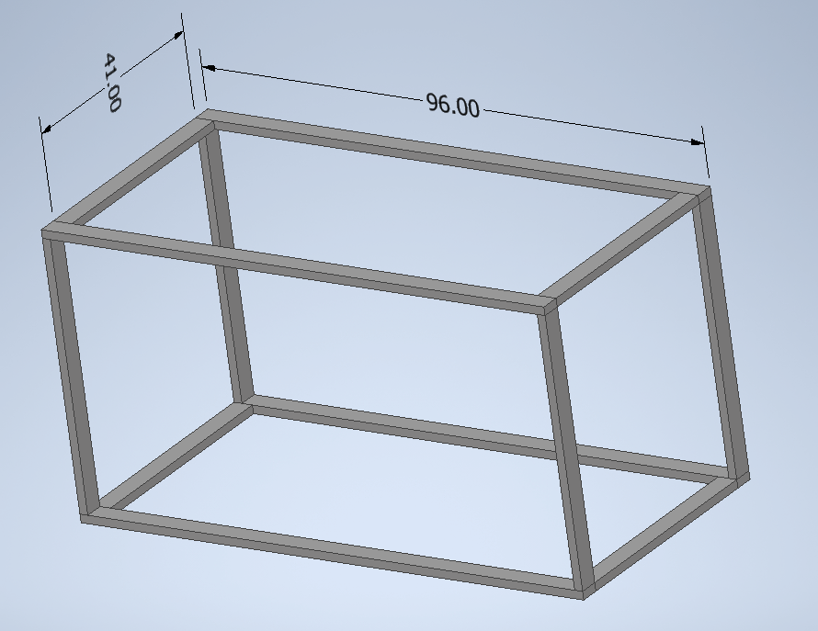
(2) 2x4x8
(2) 8’
(2) 2x4x10
(2) 41”
  Cut one from each board, save extra 79” boards

Slide 5
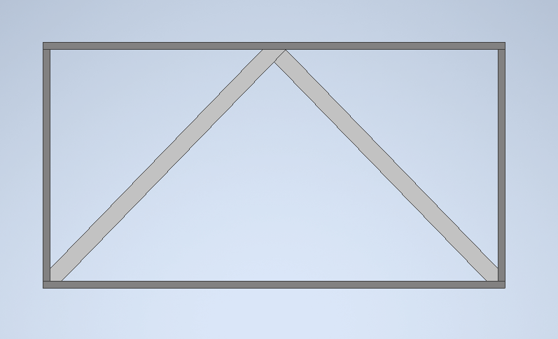
(4) Saved extras
(4) slants

Slide 6
(2) Saved extras
slants

